Slide 1
Introduction to High Throughput Computing and HTCondor
Monday AM, Lecture 1
Lauren Michael

Slide 2
Overview – 1.1
What is high throughput computing (HTC) ?
How does the HTCondor job scheduler work?
How do you run jobs on an HTCondor compute system?

Slide 3
Keys to Success
Work hard
Ask questions!
…during lectures
...during exercises
...during breaks
...during meals
If we do not know an answer, we will try to find the person who does.

Slide 4
Serial Computing
What many
programs look like:
time
Serial execution, running on one processor (CPU core) at a time
Overall compute time grows significantly as individual tasks get more complicated (long) or if the number of tasks increases
How can you speed things up?

Slide 5
High Throughput Computing (HTC)
Parallelize!
Independent tasks run on different cores
n cores
time

Slide 6
High Performance Computing (HPC)
n cores
…
time
…
…

Slide 7
High Performance Computing (HPC)
n cores
Benefits greatly from:
CPU speed + homogeneity
Shared filesystems
Fast, expensive networking (e.g. Infiniband) and servers co-located
Scheduling: Must wait until all processors are available, at the same time and for the full duration
Requires special programming (MP/MPI)
What happens if one core or server fails or runs slower than the others?
…
time
…
…

Slide 8
High Throughput Computing (HTC)
n cores
time
Scheduling: only need 1 CPU core for each (shorter wait)
Easier recovery from failure
No special programming required
Number of concurrently running jobs is more important
CPU speed and homogeneity are less important

Slide 9

HPC vs HTC: An Analogy

Slide 10


HPC vs HTC: An Analogy

Slide 11
High Throughput vs High Performance
HTC
HPC
Focus: Large workflows of numerous, relatively small, and independent compute tasks
More important: maximized number of running tasks
Less important: CPU speed, homogeneity
Focus: Large workflows of highly-interdependent sub-tasks
More important: persistent access to the fastest cores, CPU homogeneity, special coding, shared filesystems, fast networks

Slide 12
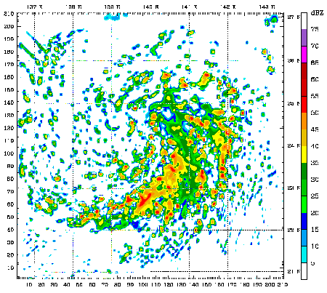
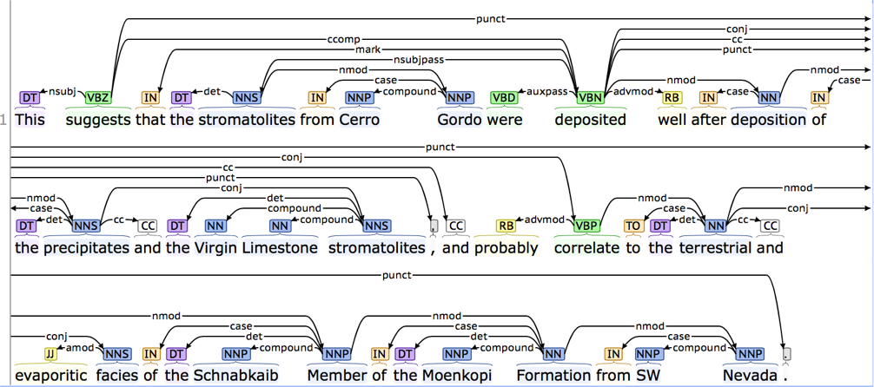
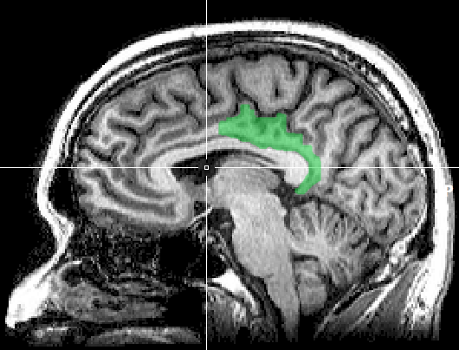
HTC Examples
text analysis (most genomics …)
multi-start simulations
parameter sweeps
statistical model optimization
(MCMC, numerical methods, etc.)
multi-image and
mulit-sample analysis

Slide 13
Is your research HTC-able?
Can it be broken into relatively numerous, independent pieces?
Think about your research! Can you think of a good high throughput candidate task? Talk to your neighbor!

Slide 14
Example Challenge
You need to process 48 brain images for each of 168 patients. Each image takes ~1 hour of compute time.
168 patients x 48 images = ~8000 tasks = ~8000 hrs
Conference is next week.

Slide 15
Distributed Computing
Use many computers, each running one instance of our program
Example:
1 laptop (1 core) => 4,000 hours = ~½ year
1 server (~20 cores) => 500 hours = ~3 weeks
1 large job (400 cores) => 20 hours = ~1 day
A whole cluster (8,000 cores) = ~8 hours

Slide 16
Break Up to Scale Up
Computing tasks that are easy to break up are easy to scale up.
To truly grow your computing capabilities, you also need a system appropriate for your computing task!

Slide 17
What computing resources are available?
A single computer?
A local cluster?
Consider: What kind of cluster is it? Typical clusters tuned for HPC (large MPI) jobs typically may not be best for HTC workflows! Do you need even more than that?
Open Science Grid (OSG)
Other
European Grid Infrastructure
Other national and regional grids
Commercial cloud systems (e.g. HTCondor on Amazon)

Slide 18

Example Local Cluster
UW-Madison’s Center for High Throughput Computing (CHTC)
Recent CPU hours:
~130 million hrs/year (~15k cores)
~10,000 per user, per day
(~400 cores in use)
CHTC Pool
single-core
high-memory
multi-core
MPI
GPUs
submit server

Slide 19
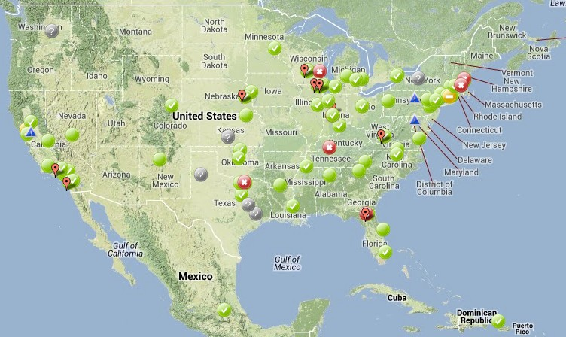
Open Science Grid
HTC for Everyone
~100 contributors
Past year:
>420 million jobs
>1.5 billion CPU hours
>200 petabytes transferred
Can submit jobs locally, they backfill across the country - interrupted at any time (but not too frequent)
http://www.opensciencegrid.org/

Slide 20
HTCondor

Slide 21

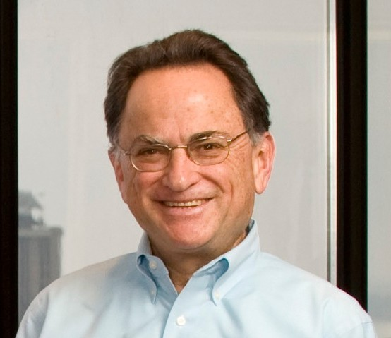
HTCondor History and Status
History
Started in 1988 as a “cycle scavenger”
Today
Developed within the CHTC team by professional developers
Used all over the world, by:
Dreamworks, Boeing, SpaceX, investment firms, …
Campuses, national labs, Einstein/Folding@Home
The Open Science Grid!!
Miron Livny, CHTC Director and HTCondor PI
Professor, UW-Madison Computer Sciences

Slide 22



HTCondor -- How It Works
Submit tasks to a queue (on a submit server)
HTCondor schedules them to run on computers (execute server)
submit point
execute
execute
execute

Slide 23
Terminology: Job
Job: An independently-scheduled unit of computing work
Three main pieces:
Executable: the script or program to run
Input: any options (arguments) and/or file-based information
Output: any files or screen information produced by the executable
In order to run many jobs, executable must run on the command-line without any graphical input from the user

Slide 24
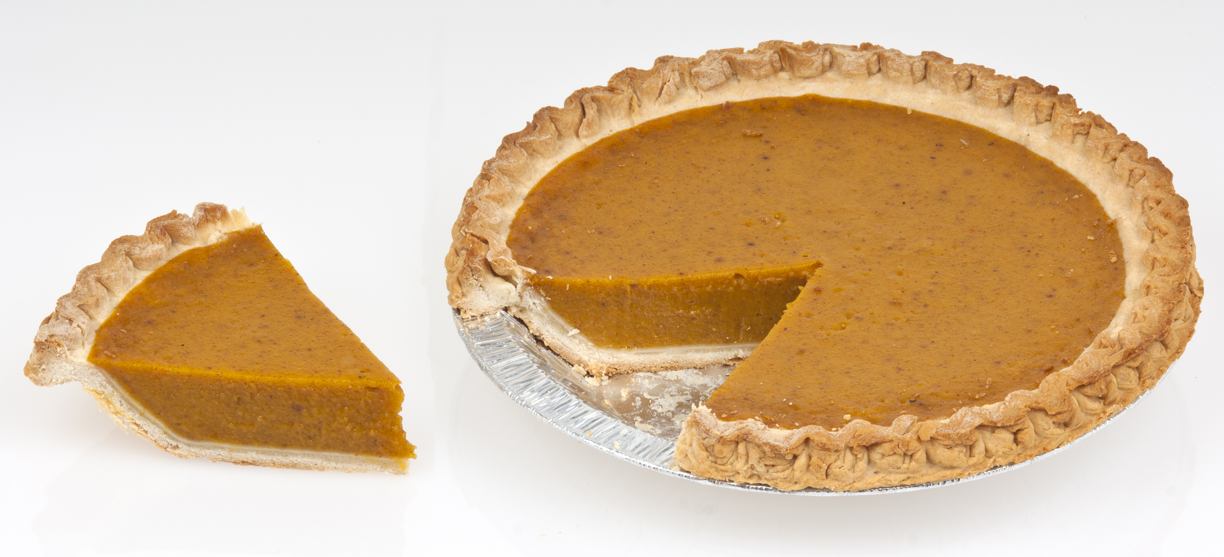
Terminology: Machine, Slot
Machine
A whole computer (desktop or server)
Has multiple processors (CPU cores), some amount of memory, and some amount of file space (disk)
Slot
an assignable unit of a machine (i.e. 1 job per slot)
most often, corresponds to one core with some memory and disk
a typical machine may have 4-40 slots
HTCondor can break up and create new slots, dynamically, as resources become available from completed jobs

Slide 25

Job Matching
On a regular basis, the central manager reviews Job and Machine attributes and matches jobs to Slots.
execute
submit
central manager
execute
execute

Slide 26
Basic Job Submission

Slide 27
Job Example
program called “compare_states” (executable), which compares two data files (input) and produces a single output file.
wi.dat
compare_
states
wi.dat.out
us.dat
$ compare_states wi.dat us.dat wi.dat.out

Slide 28
Job Translation
Submit file: communicates everything about your job(s) to HTCondor
executable = compare_states
arguments = wi.dat us.dat wi.dat.out
transfer_input_files = us.dat, wi.dat
log = job.log
output = job.out
error = job.err
request_cpus = 1
request_disk = 20MB
request_memory = 20MB
queue 1

Slide 29
Basic Submit File
executable = compare_states
arguments = wi.dat us.dat wi.dat.out
transfer_input_files = us.dat, wi.dat
log = job.log
output = job.out
error = job.err
request_cpus = 1
request_disk = 20MB
request_memory = 20MB
queue 1

Slide 30
Basic Submit File
executable = compare_states
arguments = wi.dat us.dat wi.dat.out
transfer_input_files = us.dat, wi.dat
log = job.log
output = job.out
error = job.err
request_cpus = 1
request_disk = 20MB
request_memory = 20MB
queue 1
List your executable and any arguments it takes
Arguments are any options passed to the executable from the command line
compare_
states
$ compare_states wi.dat us.dat wi.dat.out

Slide 31
Basic Submit File
executable = compare_states
arguments = wi.dat us.dat wi.dat.out
transfer_input_files = us.dat, wi.dat
log = job.log
output = job.out
error = job.err
request_cpus = 1
request_disk = 20MB
request_memory = 20MB
queue 1
Comma separated list of input files to transfer to the slot
wi.dat
us.dat

Slide 32
Basic Submit File
executable = compare_states
arguments = wi.dat us.dat wi.dat.out
transfer_input_files = us.dat, wi.dat
log = job.log
output = job.out
error = job.err
request_cpus = 1
request_disk = 20MB
request_memory = 20MB
queue 1
HTCondor will transfer back all new and changed files (output) from the job, automatically.
wi.dat.out

Slide 33
Basic Submit File
executable = compare_states
arguments = wi.dat us.dat wi.dat.out
transfer_input_files = us.dat, wi.dat
log = job.log
output = job.out
error = job.err
request_cpus = 1
request_disk = 20MB
request_memory = 20MB
queue 1
log: file created by HTCondor to track job progress
Explored in exercises!
output/error: captures stdout and stderr from your program (what would otherwise be printed to the terminal)

Slide 34
Basic Submit File
executable = compare_states
arguments = wi.dat us.dat wi.dat.out
transfer_input_files = us.dat, wi.dat
log = job.log
output = job.out
error = job.err
request_cpus = 1
request_disk = 20MB
request_memory = 20MB
queue 1
request the resources your job needs.
More on this later!
queue: keyword indicating “create 1 job”

Slide 35
Submitting and monitoring

Slide 36
Submitting and Monitoring
To submit a job/jobs: condor_submit submit_file
To monitor submitted jobs: condor_q
$ condor_submit job.submit
Submitting job(s).
1 job(s) submitted to cluster 128.
$ condor_q
-- Schedd: submit-5.chtc.wisc.edu : <128.104.101.92:9618?... @ 05/01/17 10:35:54
OWNER BATCH_NAME SUBMITTED DONE RUN IDLE TOTAL JOB_IDS
alice CMD: compare_states 5/9 11:05 _ _ 1 1 128.0
1 jobs; 0 completed, 0 removed, 1 idle, 0 running, 0 held, 0 suspended
HTCondor Manual: condor_submit
HTCondor Manual: condor_q

Slide 37
More about condor_q
By default, condor_q shows your jobs only and batches jobs that were submitted together:
Limit condor_q by username, ClusterId or full JobId, (denoted [U/C/J] in following slides).
$ condor_q
-- Schedd: submit-5.chtc.wisc.edu : <128.104.101.92:9618?... @ 05/01/17 10:35:54
OWNER BATCH_NAME SUBMITTED DONE RUN IDLE TOTAL JOB_IDS
alice CMD: compare_states 5/9 11:05 _ _ 1 1 128.0
1 jobs; 0 completed, 0 removed, 1 idle, 0 running, 0 held, 0 suspended
JobId = ClusterId .ProcId

Slide 38
More about condor_q
To see individual job details, use:
condor_q –nobatch
We will use the -nobatch option in the following slides to see extra detail about what is happening with a job
$ condor_q -nobatch
-- Schedd: submit-5.chtc.wisc.edu : <128.104.101.92:9618?...
ID OWNER SUBMITTED RUN_TIME ST PRI SIZE CMD
128.0 alice 5/9 11:09 0+00:00:00 I 0 0.0 compare_states
1 jobs; 0 completed, 0 removed, 1 idle, 0 running, 0 held, 0 suspended

Slide 39
Job Idle
$ condor_q -nobatch
-- Schedd: submit-5.chtc.wisc.edu : <128.104.101.92:9618?...
ID OWNER SUBMITTED RUN_TIME ST PRI SIZE CMD
128.0 alice 5/9 11:09 0+00:00:00 I 0 0.0 compare_states wi.dat us.dat
1 jobs; 0 completed, 0 removed, 1 idle, 0 running, 0 held, 0 suspended
Submit Node
(submit_dir)/
job.submit
compare_states
wi.dat
us.dat
job.log
job.out
job.err

Slide 40
Job Starts
$ condor_q -nobatch
-- Schedd: submit-5.chtc.wisc.edu : <128.104.101.92:9618?...
ID OWNER SUBMITTED RUN_TIME ST PRI SIZE CMD
128.0 alice 5/9 11:09 0+00:00:00 < 0 0.0 compare_states wi.dat us.dat
1 jobs; 0 completed, 0 removed, 0 idle, 1 running, 0 held, 0 suspended
Submit Node
Execute Node
(submit_dir)/
job.submit
compare_states
wi.dat
us.dat
job.log
job.out
job.err
(execute_dir)/
compare_states
wi.dat
us.dat

Slide 41
Job Running
$ condor_q -nobatch
-- Schedd: submit-5.chtc.wisc.edu : <128.104.101.92:9618?...
ID OWNER SUBMITTED RUN_TIME ST PRI SIZE CMD
128.0 alice 5/9 11:09 0+00:01:08 R 0 0.0 compare_states wi.dat us.dat
1 jobs; 0 completed, 0 removed, 0 idle, 1 running, 0 held, 0 suspended
Submit Node
Execute Node
(submit_dir)/
job.submit
compare_states
wi.dat
us.dat
job.log
job.out
job.err
(execute_dir)/
compare_states
wi.dat
us.dat
stderr
stdout
wi.dat.out

Slide 42
Job Completes
$ condor_q -nobatch
-- Schedd: submit-5.chtc.wisc.edu : <128.104.101.92:9618?...
ID OWNER SUBMITTED RUN_TIME ST PRI SIZE CMD
128 alice 5/9 11:09 0+00:02:02 > 0 0.0 compare_states wi.dat us.dat
1 jobs; 0 completed, 0 removed, 0 idle, 1 running, 0 held, 0 suspended
Submit Node
Execute Node
(submit_dir)/
job.submit
compare_states
wi.dat
us.dat
job.log
job.out
job.err
(execute_dir)/
compare_states
wi.dat
us.dat
stderr
stdout
wi.dat.out
stderr
stdout
wi.dat.out

Slide 43
Job Completes (cont.)
$ condor_q -nobatch
-- Schedd: submit-5.chtc.wisc.edu : <128.104.101.92:9618?...
ID OWNER SUBMITTED RUN_TIME ST PRI SIZE CMD
0 jobs; 0 completed, 0 removed, 0 idle, 0 running, 0 held, 0 suspended
Submit Node
(submit_dir)/
job.submit
compare_states
wi.dat
us.dat
job.log
job.out
job.err
wi.dat.out

Slide 44
Your turn!
CHTC Pool
single-core
high-memory
multi-core
MPI
GPUs
submit server

Slide 45
Thoughts on Exercises
Copy-and-paste is quick, but you WILL learn more by typing out commands (first) submit file contents
Exercises 1.1-1.3 are most important to finish THIS time (see 1.6 if you need to remove jobs)!
If you do not finish, that’s OK – You can make up work later or during evenings, if you like. (There are even “bonus” challenges, if you finish early.)

Slide 46
Exercises!
Ask questions!
Lots of instructors around
Coming next:
Now: Hands-on Exercises
10:30 – 10:45 Break
10:45 – 11:15 Submitting Many Jobs
11:15 – 12:15 Hands-on Exercises

